Slide 1
COMPUTATIONAL TRANSCRIPTOMICS · BIOINFORMATICS
Molecular Landscape of Glioblastoma
through Gene Expression
Differential Expression & Network Analysis of the Ivy Glioblastoma Atlas Project (Ivy GAP)
Presented by
Nada Ibnouf
Maziar Abedzadeh
Bioinformatics Internship
BITC2486 · Spring 2026
Professor Nihal Salem

Slide 2
00
·
AGENDA
Presentation Roadmap
A 14-minute walkthrough — from disease biology to molecular engines.
01
5 min
02
7 min
03
2 min
Introduction
Analysis
Conclusion
Glioblastoma biology
Ivy GAP dataset
Workflow & methodology
PCA — Quality Control
DESeq2 — Differential Expression
WGCNA — Co-expression Networks
Key findings
Biological significance
Q & A
NADA + MAZIAR
NADA + MAZIAR
MAZIAR
GBM Microstructure DGE · Ivy GAP Analysis
AGENDA
2

Slide 3
SECTION 01
Introduction
What is GBM, and why the Ivy GAP atlas matters.
GBM Microstructure DGE · Ivy GAP Analysis

Slide 4
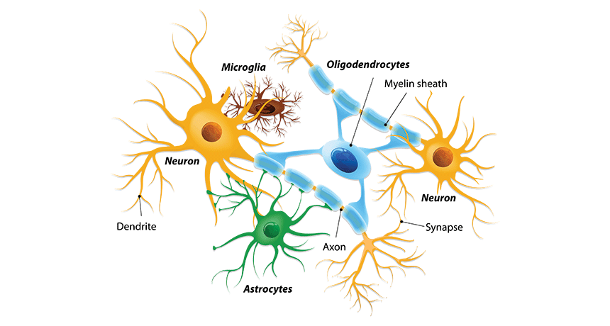
What is Glioblastoma?
Brain Cell Types
01
·
BACKGROUND
A Grade 4 primary brain tumor — aggressive, infiltrative, and structurally heterogeneous.
Glioblastoma (GBM) is the most aggressive Grade 4 primary brain cancer.
Median Overall Survival
Typically, 12 to 18 months with standard medical intervention. Without treatment, survival drops sharply to approximately 3-4 months.
It originates in astrocytes — glial cells responsible for supporting the brain and providing nutrition.
DEFINITION
Hypoxic core vs invasive edge — distinct cellular ecosystems
GBM Microstructure DGE · Ivy GAP Analysis
BACKGROUND
4

Slide 5
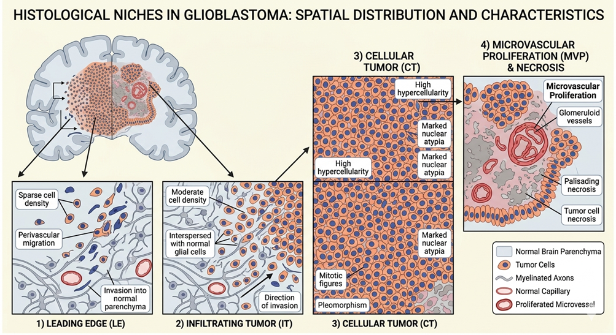
TUMOR ARCHITECTURE
GBM is structurally heterogeneous: a hypoxic Cellular Tumor (CT) core forms pseudopalisading necrosis (cells crowding around dying tissue), surrounded by an Infiltrating Tumor (IT) leading edge that invades healthy brain.
WHY IT MATTERS
Surgery removes the CT core, but IT cells survive and drive recurrence. Mapping IT vs CT gene expression is the most direct route to drug targets that stop the spread.

Slide 6
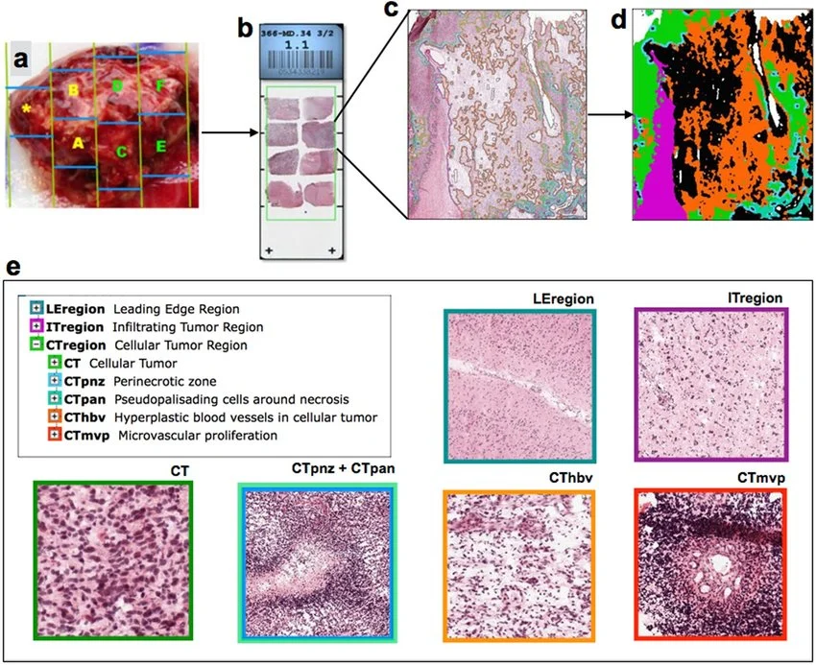
02
·
DATASET
Workflow of the Ivy GAP Project
From surgical resection → laser microdissection → RNA sequencing.
FIVE-STEP PIPELINE
a
Surgical resection — tumor divided into blocks.
b
Histological sectioning into thin slices.
c
Histopathological evaluation by experts.
d
Annotation of distinct GBM histological regions.
e
Laser microdissection + RNA-seq per region.
GBM Microstructure DGE · Ivy GAP Analysis
DATASET
6

Slide 7
02
·
DATASET
The Ivy Glioblastoma Atlas Project (Ivy GAP)
A high-resolution transcriptional atlas — laser microdissection meets RNA-seq.
122
10
5
~20K
RNA-seq samples
unique tumors
anatomical regions
genes quantified
RESEARCH QUESTION
How does gene expression shift across glioblastoma tumor regions — from the dense core to the invasive edge?
Ivy GAP links clinical, genomic, and anatomic data from 42 tumors to map gene expression across five tumor regions, capturing both intra- and inter-tumor heterogeneity.
GBM Microstructure DGE · Ivy GAP Analysis
DATASET
5

Slide 8
SECTION 02
Analysis
PCA · Differential Expression (DESeq2) · Co-expression Networks (WGCNA)
GBM Microstructure DGE · Ivy GAP Analysis

Slide 9
03
·
METHODOLOGY
What is RNA Sequencing?
Counting transcripts to measure gene expression genome-wide.
WHAT IS RNA-SEQ?
A high-throughput method that converts every mRNA molecule in a sample into a sequenceable read — producing a digital count of how active each gene is.
RNA-SEQ WORKFLOW
a
Extract mRNA from each microdissected tissue sample.
b
Reverse-transcribe mRNA into stable cDNA.
c
Sequence cDNA fragments → millions of short reads.
WHY USE IT FOR GBM?
Quantifies ~20,000 genes simultaneously across all 122 Ivy GAP samples — the foundation for every comparison we make between tumor regions in DESeq2 and WGCNA.
d
Map reads back to the human reference genome.
e
Count reads per gene → gene expression count matrix.
GBM Microstructure DGE · Ivy GAP Analysis
METHODOLOGY
7

Slide 10
03
·
METHODOLOGY
RNA-seq Analysis — Two Complementary Lenses
DESeq2 finds individual “star genes.” WGCNA reveals the “gene teams” that drive them.
DESeq2
WGCNA
INDIVIDUAL STAR GENES
GENE TEAMS — FUNCTIONAL ENGINES
Log₂ Fold Change — magnitude of expression change between conditions.
Adjusted p-value — statistical confidence after multiple testing correction.
Hub genes — most highly connected genes in a module; act as master regulators of the program.
Module–trait correlation — links a gene module to a clinical or anatomical trait.
Combined: from a list of genes → the program GBM uses to spread.
GBM Microstructure DGE · Ivy GAP Analysis
METHODOLOGY
8

Slide 11
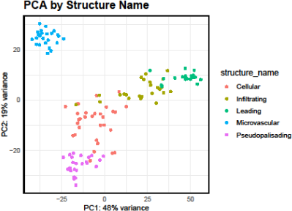
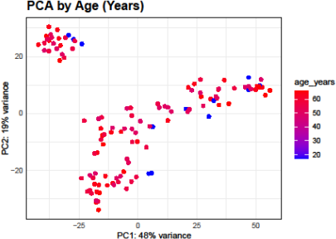
04
·
QUALITY CONTROL
Principal Component Analysis (PCA)
Are samples grouping by biology — or by demographics?
By anatomical structure
By patient age (years)
TAKEAWAY · Biological structure (not patient age) dominates the dataset's variability — clusters track tumor regions, not demographics.
GBM Microstructure DGE · Ivy GAP Analysis
QUALITY CONTROL
9

Slide 12
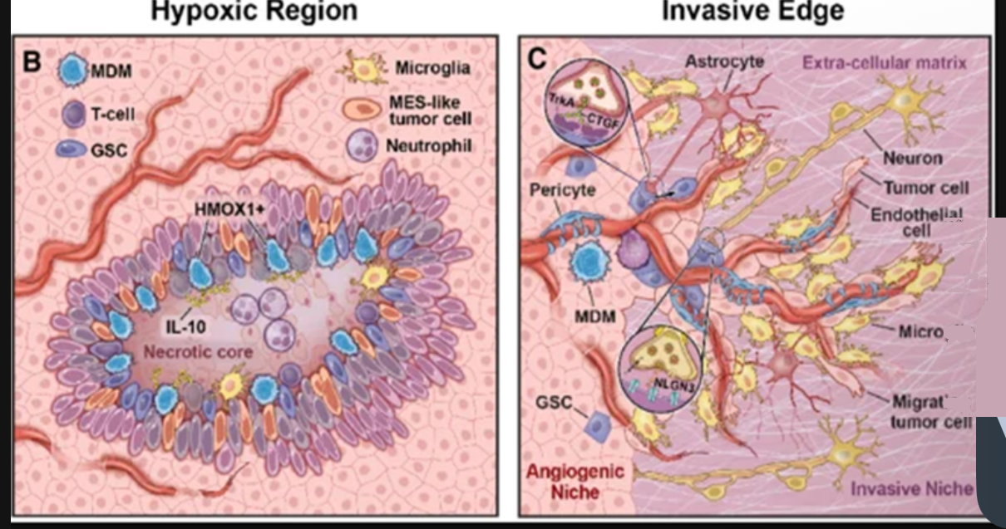
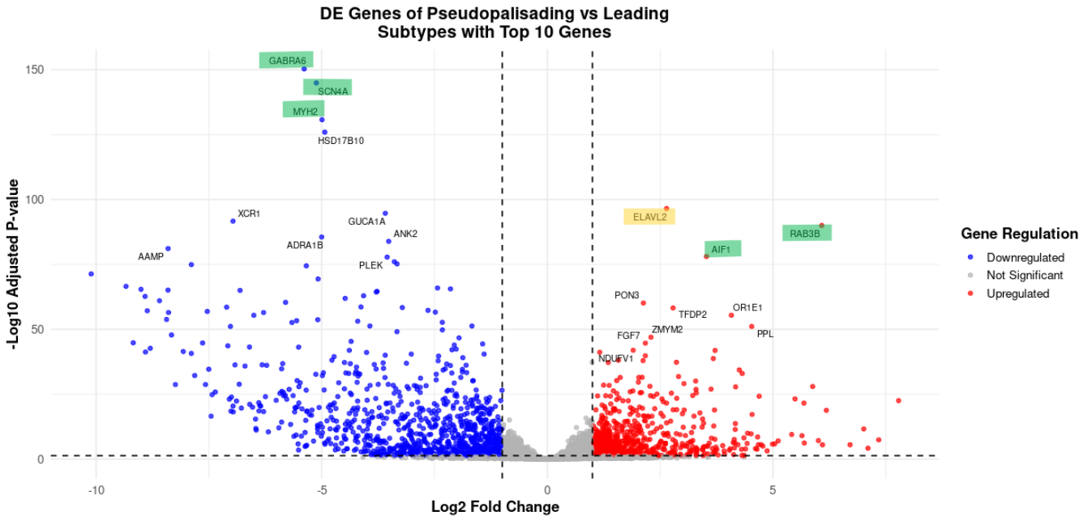

05
·
DESEQ2
Gene Expression Changes: Pseudopalisading vs Leading Edge
FINDING · Two distinct molecular signatures separate the dense core from the invasive edge — distinct biology, distinct therapeutic targets.
GBM Microstructure DGE · Ivy GAP Analysis
DESEQ2
10

Slide 13
05
·
DESEQ2
Biological Significance of DE Genes
From statistical hits to functional roles — what each gene does in tumor biology.
ELAVL2
TUMOR SUPPRESSOR
AIF1
IMMUNE ACTIVITY
RAB3B
ONCOGENE
High levels improve survival by blocking aggressive, therapy-resistant cell states.
Marks inflammation-driven immune activity in the tumor — may aid growth or immune evasion.
Promotes proliferation and migration via vesicle trafficking; linked to drug resistance.
GABRA5
THERAPEUTIC TARGET
SCN4A
BRAIN INFILTRATION
MYH2
CELL CRAWLING
Inhibition blocks tumor spread — a candidate druggable receptor at the leading edge.
Sodium channel mutations help tumor cells infiltrate brain tissue and worsen survival.
Myosin enables physical crawling and remodeling of the environment to facilitate invasion.
■ Pseudopalisading (core, hypoxic) ■ Leading Edge (invasive front)
GBM Microstructure DGE · Ivy GAP Analysis
DESEQ2
11

Slide 14
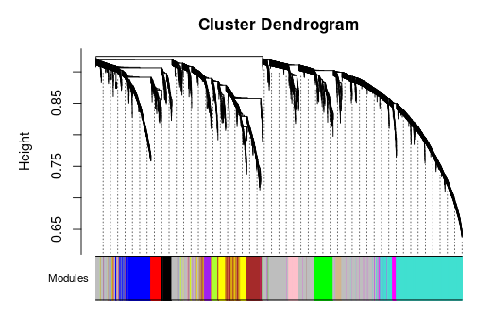
06
·
WGCNA
WGCNA Identified Modules of Genes with Correlated Expression
Hierarchical clustering by topological overlap reveals co-expression modules.
MODULES
Color-coded clusters at the bottom. Turquoise and blue are the largest, most highly co-expressed groups.
GREY MODULE
Genes that don't fit any module — flagged as unassigned or noisy.
STRUCTURE
Branches split as height drops (0.90 → 0.60). Lower merges = higher gene-gene similarity.
Y-axis: 1 − topological overlap (dissimilarity). Lower = more similar.
GBM Microstructure DGE · Ivy GAP Analysis
WGCNA
12

Slide 15
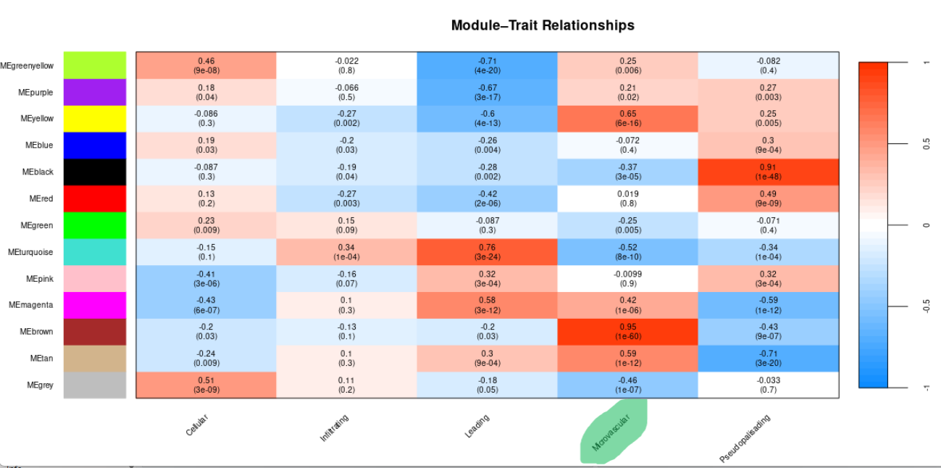
07
·
NETWORK ANALYSIS
Module–Trait Relationships
Linking gene modules to anatomical regions — where each program is most active.
KEY CORRELATIONS
MEbrown × Microvascular
r = 0.95 (p = 1×10⁻⁶⁰)
Strongest positive — angiogenic hub program.
MEturquoise × Leading
r = 0.76 (p = 3×10⁻²⁴)
Strong link to invasive edge biology.
MEblack × Pseudopalisading
r = 0.91 (p = 1×10⁻⁴⁸)
Hypoxic-core gene program.
GBM Microstructure DGE · Ivy GAP Analysis
NETWORK ANALYSIS
14

Slide 16
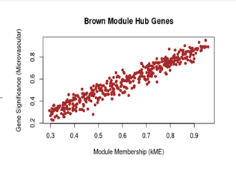
08
·
HUB GENES
Hub Genes & Microvascular Subtype
Module Membership (kME) vs Gene Significance — identifying master regulators.
BROWN MODULE
Strong POSITIVE correlation — hub genes are key drivers of the microvascular program.
Hub genes (kME > 0.9) are master regulators — their expression coordinates entire functional programs.
GBM Microstructure DGE · Ivy GAP Analysis
HUB GENES
15

Slide 17
09
·
FINDING #1
Brown Module — The Angiogenic Engine
560 co-expressed genes that together drive the tumor's blood supply.
ENRICHED GO BIOLOGICAL PATHWAYS
Top biological themes driven by the Brown module — all converging on tumor vasculature.
Sprouting angiogenesis
Endothelial cell migration
Vasculogenesis
Blood vessel morphogenesis
Vascular process in circulatory system
Substrate adhesion
MASTER REGULATORS · kME > 0.93
KDR
VEGFR2 — on-switch for tumor blood-vessel growth; targeted by Bevacizumab (Avastin).
FLT4
VEGFR3 — regulates lymphatic and vascular remodeling in aggressive tumors.
EFNB2
Regulates endothelial cell migration and vessel patterning.
FOXC1
Transcription factor — promotes tumor cell plasticity and vascular invasion.
GO biological pathways enriched in the Brown module
GBM Microstructure DGE · Ivy GAP Analysis
FINDING #1
16

Slide 18
SECTION 03
Conclusion
From statistical hits to the molecular program GBM uses to spread.
GBM Microstructure DGE · Ivy GAP Analysis

Slide 19
12
·
SUMMARY
Key Findings — One-Sentence Conclusions
We identified the molecular switches and engines GBM uses to migrate from core to healthy tissue.
01
QUALITY CONTROL — PCA
Biological structure (not patient age) drives sample variability. Anatomical regions cluster cleanly, justifying region-based comparisons.
02
DESEQ2 — DIFFERENTIAL EXPRESSION
Distinct gene signatures separate Pseudopalisading (RAB3B, AIF1, ELAVL2) from Leading Edge (GABRA6, SCN4A, MYH2) — distinct biology, distinct druggable targets.
03
WGCNA — TWO FUNCTIONAL ENGINES
Brown module = angiogenic engine (KDR/VEGFR2, FLT4 — vascular machinery). Turquoise module = infiltration engine (CHKA, SYP — brain mimicry via neurotransmitter pathways) — coordinated programs, not isolated genes.
DESeq2 + WGCNA together reveal not just which genes change — but the programs they belong to.
GBM Microstructure DGE · Ivy GAP Analysis
SUMMARY
20

Slide 20
END OF DECK
Thank you.
Questions welcome.
WITH GRATITUDE
Special thanks to Professor Nihal Salem for the guidance, mentorship, and scientific direction that shaped both the analysis and the biological interpretation of these results.
— Nada Ibnouf & Maziar Abedzadeh
Differential Gene Expression Analysis of Glioblastoma Microstructures · Ivy GAP

